Slide 1


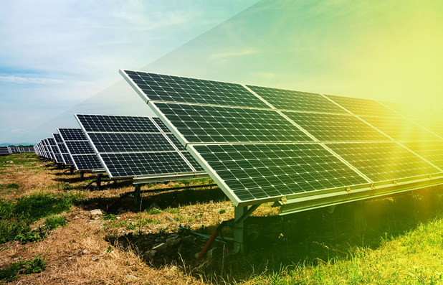

WEBINAR SOLARISE
25 June 2020 | 15h00 – 16h00
Thanks for joining!
The webinar will start at 15h00 C.E.T.

Slide 2
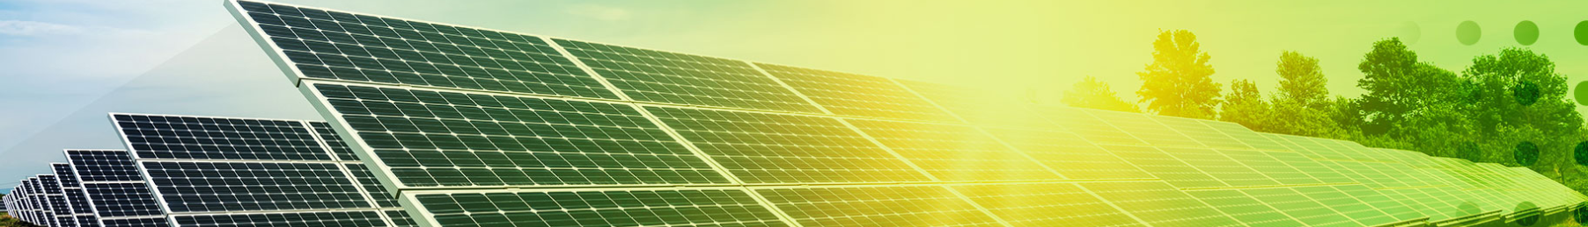



GUIDELINES
Turn off your camera and microphone
Ask questions at any time via chat function
Raise your hand during Q & A
Turn camera and mic on when asking question
Turn your off camera and microphone again

Slide 3
PROGRAMME
15h00 - Welcome & Scope of the SOLARISE project
Prof. Ahmed Rachid, University of Picardie Jules Verne
15h10 - 3 pilot projects on municipal buildings in Fourmies Arpan Dutta, Ville de Fourmies
15h20 - Multi-agent Modelling of Households with PV solar generation and energy storage (video)
Sree Harsha Bandaru, PhD student - University Portsmouth
15h23 - Spatial Energy strategy for a new district around trainstation in Heerhugowaard (video)
Benedikt Marschutz, Municipality of Heerhugowaard
15h25 - Q&A – session II
15h30 - Solarise - acadamic living lab at KU Leuven, as sociotechnical imaginary for solar technologies
Emilia Motoasca - University of Leuven / TC Ghent
15h40 - A Solar PV/T living lab as a cyber-physical system - Zain Ul Abdin, PhD-student, University of Picardie Jules Verne
15h45 - Pilot project in Middelburg of an integrated system in rooftiles 'Q-Roof' (video) - various speakers
15h50 - Q&A - session
15h55 - Closing remarks

Slide 4

WEBINAR SOLARISE
25 June 2020 | 15h00 – 16h00
Thank you for your attention!
Follow us on:

